Slide 1
DATAGRAM NETWORKS
Presented by : Dimpy Senchoudhury
Roll no. : 16800117049
3rd year CSE

Slide 2
CONTENTS
Introduction
What is a Datagram Network?
Figure to demonstrate Datagram Network
Routing Table
Figure to demonstrate Routing Table
Destination Address
Efficiency
Delay
Figure to demonstrate Delay
Conclusion

Slide 3
INTRODUCTION
In data communications, we need to send messages from one end system to another. If the message is going to pass through a packet-switched network, it needs to be divided into packets of fixed or variable size. The size of the packet is determined by the network and the governing protocol.

Slide 4
WHAT IS A DATAGRAM NETWORK?
In a datagram network, each packet is treated independently of all others. Even if a packet is part of a multi packet transmission, the network treats it as though it existed alone. Packets in this approach are referred to as datagrams. Datagram switching is normally done at the network layer.

Slide 5
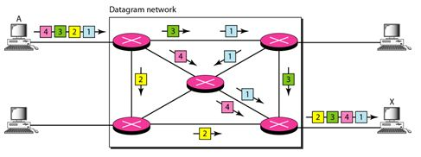
FIGURE TO DEMONSTRATE DATAGRAM NETWORK
The following figure shows how the datagram approach is used to deliver four packets from station A to station X. The switches in a datagram network are traditionally referred to as routers.

Slide 6
ROUTING TABLE
In this type of network, each switch (or packet switch) has a routing table which is based on the destination address. The routing tables are dynamic and are updated periodically.
The destination addresses and the corresponding forwarding output ports are recorded in the tables.
This is different from the table of a circuit switched network in which each entry is created when the setup phase is completed and deleted when the teardown phase is over.

Slide 7
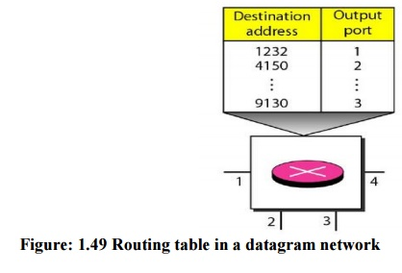
FIGURE TO DEMONSTRATE ROUTING TABLE
The following figure shows the routing table for a switch.

Slide 8
DESTINATION ADDRESS
Every packet in a datagram network carries a header that contains, among other information, the destination address of the packet.
When the switch receives the packet, this destination address is examined; the routing table is consulted to find the corresponding port through which the packet should be forwarded.

Slide 9
EFFICIENCY
The efficiency of a datagram network is better than that of a circuit-switched network. Resources are allocated only when there are packets to be transferred.
If a source sends a packet and there is a delay of a few minutes before another packet can be sent, the resources can be reallocated during these minutes for other packets from other sources.

Slide 10
DELAY
There may be greater delay in a datagram network than in a virtual-circuit network. Although there are no setup and teardown phases, each packet may experience a wait at a switch before it is forwarded.
In addition, since not all packets in a message necessarily travel through the same switches, the delay is not uniform for the packets of a message.

Slide 11
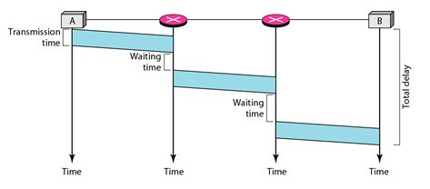
FIGURE TO DEMONSTRATE DELAY
The following figure gives an example of delay in a datagram network for one single packet.

Slide 12
CONCLUSION
The Internet has chosen the datagram approach to switching at the network layer. It uses the universal addresses defined in the network layer to route packets from the source to the destination.
A datagram is primarily used for wireless communication and is self-contained with source and destination addresses written in the header. It is similar to a packet, which is a small piece of data transmitted through a connectionless protocol; but a datagram cannot handle prior or subsequent data communication.

Slide 13
THANK YOU !!

